Slide 1
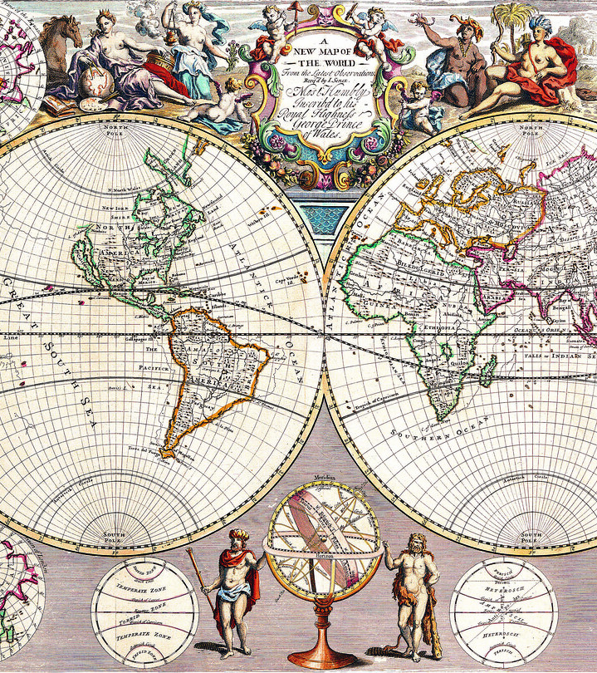
AP World
2022-2023
Mrs Oleson
JamieO@spokaneschools.org
509-354-6661
Please email, if you have questions.

Slide 2
About Mrs. Oleson
Teacher at Rogers High School for 27 years
Degrees: B.A. Interdisciplinary Studies and History/Social Sciences
M.A. Curriculum and Instruction
National Board Teacher in Social Sciences/History
Certificates: Social Sciences/History/English/ELD
Born in the USA, raised in India and Malaysia (so if you hear interesting stories- it is true ☺)
(Picture of me and my granddaughter)

Slide 3
Course Content
There are NINE Units that are broken into 4 Periods
Unit 1 and 2 cover the period of 1200-1450: Global Tapestry and Networks for Exchange
Unit 3 and 4 cover the period of 1450-1750: Land-Based Empires and Transoceanic Interconnections
Unit 5 and 6 cover the period of 1750-1900: Revolutions and Consequences of Industrialization
Unit 7, 8, 9 cover the period of 1900 to the Present: Global Conflict, Cold war and Decolonization and Globalization
ALL Content is from the College Board
(click on hyperlink)

Slide 4
Homework and other…
During the week- students have homework EVERY day
Reading
Vocabulary
Studying for Quizzes/Tests/Exam
Reviewing previous units
Students will have a calendar that tells them what they should be doing – please check this out! (note- this calendar does change because of events out of my control/knowledge)
If an assignment is late- the highest a student can get on that LATE assignment is 60%. (OBVIOUSLY if there are extenuating circumstances, I am understanding, and the student should talk to me)
IF a student is absent for a quiz/test/exam- they have 2 days to make this up from the time they are back at school.
WHEN the student passes the AP Exam on May 11th, they have the opportunity to receive College credit- this is a COLLEGE READINESS class.

Slide 5
Grades
Everything we do is to help us pass the AP Exam on May 11th (8am)
50% Exams (there are 4)- one for each period
30% Quizzes/Test- one for each unit or chapter
20% Homework (Reading notes, vocabulary and other activities)
There are EXAM corrections which will be given after each Exam- students can earn back ½ credit for incorrect answers- very specific way to do this
There are NO redo’s.

Slide 6
Support for Students
Remind APP- I send a reminder to students almost every day on what needs to be accomplished for homework or if there are changes in the calendar/schedule
AFTER SCHOOL- I am here MOST days after school- students are MORE than welcome to come in- this is an excellent way to get help
EMAIL- I encourage students to EMAIL me if they cannot come in- when they go to college/running start, parents are not able to contact professors, this is a great way to start having students become advocates for their learning.
Students will have their own book AND will need their computer and the College Board account (I will be helping them sign in)

